Slide 1
Facial Recognition and Automation
By
Abhijit Pramanick
Ankur Sarkar

Slide 2
The project presents a low cost and flexible home control and monitoring system using an embedded microprocessor and microcontroller, with IP connectivity for accessing and controlling devices and appliances remotely using Smart phone application. The proposed system does not require a dedicated server PC with respect to similar systems and offers a novel communication protocol to monitor and control the home environment with more than just the switching functionality. To demonstrate the feasibility and effectiveness of this system, devices such as light switches, power plug, temperature sensor and current sensor can be integrated with the home control system.

Slide 3
The Internet of Things (IoT) can be described as connecting everyday objects like smart-phones, Internet TVs, sensors and actuators to the Internet where the devices are intelligently linked together enabling new forms of communication between things and people, and between things themselves. Building IoT has advanced significantly in the last couple of years since it has added a new dimension to the world of information and communication technologies.

Slide 4
Problem Statement
The focus of my project is to recognize the residents of the house by facial recognition and operating the less heavy works like locking and unlocking the main door of the house switching on and off fans jamming of cellular networks and wifi after a given time so that everybody can have a sound sleep. The objective of our system is to take care of several domestic systems that may normally be difficult for those who are handicap or elderly to take care of. This application will allow the user to control a device that is connected to any home appliance that is Pi enabled. The focus of this application will be to direct a security system with webcam surveillance, door sensor notification and a light control system. Sensors will be connected to the home appliances with Pi so that they can be monitored and controlled.

Slide 5
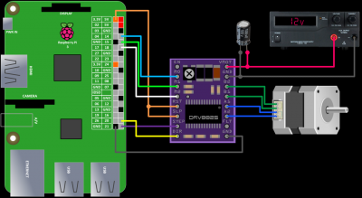
Raspberry Pi enabled DRV8825 for connection with the stepper

Slide 6
Suppose an employee who has gone to work and during this period a thief sneaks up into the house breaking through a window. The proposed system would enable the client to monitor his home when a door or a window sensor triggers the alarm. Client monitors his home with webcam and could immediately inform local authority or a policeman. The Client could also check the status of the outside light and turn on and off the light without the need to get out of bed. These devices would also benefit users with limited mobility that may have a difficult time getting to or even reaching their light switch. These objectives require a large amount of technology. The user interface must be as simple and powerful as possible and operate in a selforganized way.

Slide 7
PI ENABLED SMART HOME DEVICES
Raspberry Pi: A microprocessor will interface with the android module to perform the automation. A simple microprocessor will receive signals from the smartphone and it will be processed.
Develop Software Interface Mobile Device: An android application to be developed using the ADT (Android Developer Tools) java platform for programs running on mobile devices that communicates between pi and home devices easily.
Integrate the Sensors to a Device: The Raspberry Pi needs to be integrated with the lighting, door sensors and webcam control systems at a low cost with easy installation.

Slide 8
THANK YOU

